Slide 1
OPTIMIZATION ALGORITHM
Sebastien Charnoz & Andrea Ciardi
https://sites.google.com/view/paris-physics-master/first-semester-courses/numerical-methods-for-physics
Paris Physics Master

Slide 2
Many problems need to minimize a function or find an optimal solution;
Minimizing the distance (XHI2) between data points and a model
Find the equilibrium state of a mechanical system (Minimize E_{pot})
Find the equilibrium state of a gas, a chemical composittion (Maximize Entropy)
All optimization problems :minimize cost in engineering, minimize time
…
- Data Processing : machine learning, image processing ….
All these problems come in a wide category: optimization
Note: Maximize F (x) = Minimize -F (x)
Minimize and maximize are actually the same problem !

Slide 3
Examples :
Finding the optimal size of a rectangular garden with a given perimeter
Finding the cylinder with the smallest surface , with constant volume to
Minimize cost.

Slide 4
Find the minimum point of a given function with complex shape
Find the best model that fits some data points.

Slide 5
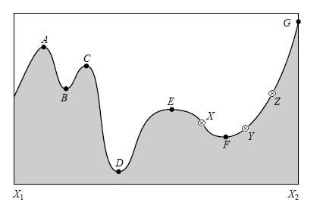
Once again, it is an ill-posed problem:
There is NO ideal method.
It is quite easy (i.e. fast) to find a local minimum.
It is very difficult (i.e. long) to find a global minimum
B, D, F are local minima
D is the global minimum
This research is particularly long and difficult if the problem is N-dimensional (N>2)

Slide 6
Let n, m, and p be positive integers. Let X be a subset of R^{n}, let f, g_{i}, and h_{j} be real-valued functions on X for each i in {1, …, m} and each j in {1, …, p}, with at least one of f, g_{i}, and h_{j} being nonlinear.
A nonlinear minimization problem is an optimization problem of the form
There are different categories of problem :
Unconstrained optimization :
We try to find the minimum of a function F (or of a vector of functions) for some
variable (x) with NO constrain on x (basic case)
Constrained optimizaion :
We try to find th minimum of a function F WITH constrained on the variable X.
Linear optimization :
Minimize C^{T} X, Subject to A X <b, x >0 (the « garden » problem)
Non linear optimization : (Cylinder problem)
Chemical reaction at equilibrium:
To find the composition at equilibrium the chemical potential must be minimized of the system but must be respected that the total mass of the system is preserved ...
There are also specific methods for these cases.

Slide 7
Most method are first built for 1D problem (x is a scalar)
For Multi-dimensional problems, numerous methods try extend the 1D case.
Note :
All methods start from an « initial guess » and then try to find the closest minimum => IMPORTANCE OF THE FIRST GUESS.
For REAL TOUGH PROBLEMS
Multidimensional optimization, global minimum finding, data mining
New families of algorithm :
Genetic Algorithm, simulated annealing, machine learning..

Slide 8
1D unconstrained mimization
The most classic method is the famous gradient descent:
We want to find A minimum of F(x), starting from a point X₀ given by the user
We explore F(x) always « Downslope » => in the direction of the local gradient.
G=starting point
F =minimum found (closest)
This is why most algorithms find of the local minima
not the absolute minimum
A big part of the computation
Time and difficulty is
is to compute the derivative H '(x)

Slide 9
IMPORTANCE OF THE FIRST AND SECOND DERIVATIVES F’(X) AND F’’(X)
Reminder : if x is a minimum of F(x) then F’(x)=0
So :If you KNOW F’(X) (gradient) this will make your life MUCH EASIER
If you use a minimization algorithm
IT MEANS you CANNOT analytically calculate the zeros of F '(X)
Either because you do not know F '(x)
Either because solve F '(X) = 0 is too complicated.
Or because F(X) is a complex function.
BUT IF YOU KNOW F’(X) THIS WILL BE VERY USEFUL AND WILL
SAVE A LOT OF TIME

Slide 10
MINIMIZE WITH DOWN GRADIENT known derivative
We know F and we assume we know F’ (X)
Starting from a starting point X₀ ( ’first guess’), we compute a serie of points as follows :
where g_{k} is the direction of descent (« left or right » in 1D) an d_{k} is the length of
The step
The choice of g_{k} is such that f (X_{k + 1}) <F (X_{k}). A natural choice is :
In the simplest method of descent gradient, g is simply « minus the gradient of F »
Note : here g_{k} is not normalized to 1

Slide 11
g₀
g₁
x₀
Example 1D
g_{i} is less gradient of point i
x₁
g₂
F (x)
x₂
x₄
g₃
g₄
x₃
g₅
x₅
X
2 questions:
How to choose the step-size d_{k} ? (it must be smart)
- When does the calculation stops .

Slide 12
The « Fixed » descent
If one does not know the second derivative descend the fixed pitch gradient.
we impose d_{k}= cst at the beginning of the calculation.
What value do to d? Hard to say a priori. In general it takes d <the characteristic size of the research area. For example the width of the valley.
The descent fixed not only on if the function is soft, and if the point Start is close to the solution.
The test will stop when
|| f '(x_{k}) || <epsilon
or X ||_{k}-X_{k + 1}|| / || X_{k}|| <epsilon
Warning: "fixed pitch" is an abusive name. The REAL no progress is: dxg_{k} where g_{k} is -F '(X)
This is the multiplicative factor that is constant.

Slide 13
Choice of the Step Size d_{k}
requires knowing the second derivative !! :
One makes a locally parabolic approximation of the function
It is based on the Taylor Expansion (T.E.) of F (x) at point X_{k}
T.E. of the derivative.
We want to cancel the derivative So, we choose to dx_{k} so that F '(X_{k}+ dx_{k}) = 0

Slide 14
Now with our notation:
And g_{k}= -F (X_{k}) from where the "no" of progress_{k} dx =_{k}/ F (X_{k})
This method is quadratic.
The advantage of this method is that it generalizes well N-dimensional problems

Slide 15
But Often it can be difficult to compute F’(X) …and F’’(X) !!
Example : the XHI2 test :

Slide 16
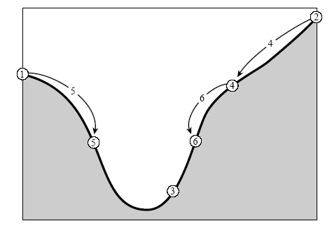
MINIMIZATION 1D WITHOUT GRADIENT (Bisection)
This is the easiest method, very similar to the method of bisection to find a zero
General method
c
Framing the minimum of three points:
a <b <c
such that f (b) <f (a) f (b) <f (c)
The_{ab}= ba and L_{bc}cb =
at
We start from a and b and c
calculates f (a), f (b), f (c)
If L_{ab}> L_{bc} We take X = medium (a, b)
If f (x) <f (b) then c = b and b = x
If a = x, b and c are kept
5. If L_{bc}> L_{ab} We take X = medium (b, c)
If f (x) <f (b) then a = b and b = x
If x = c, a and b are kept
6. Returns 2
b
Basic Method

Slide 17
exemple :
If BC> AB
C
A
X is chosen in the
Largest segment
B
Replacing right if (f(X) > F(B) and F(X)< F(C)
Replacing C
C
A
A
X
B
B
C
At the end of the stage:
F (b) <F (a) and F (b) <F (c)

Slide 18
Method of the "Golden rule" to find X
In fact it can be shown that there is an optimal way to choose again point X in a single step.
the largest of the two right left segments (|| AB || and || CB||) is chosen :
. Let L be the segment length
We take the new point X inside this segment in the distance:
0.39197 x L (golden ratio) from point B
If F (x) <F (B) then B = X or if F (x) <F (c) then C = X
C
AT
B
X
So that (aX) / (BC) = 1.618
The Golden ratio
0.3917 || CB ||

Slide 19
a
b
c
Δ
How to choose a and b ?
Keep the proportions for each iteration:
To the left Δ/ A = a / b and to the right Δ/ (B Δ ) = A / b
is eliminated Δ and include: a / b ~ 1.618 .. The golden number
However, whereas you are sur not to spend too much time fo find the minimum,
This is not ALWAYS faster than the simple bissection

Slide 20
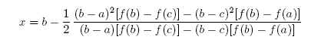
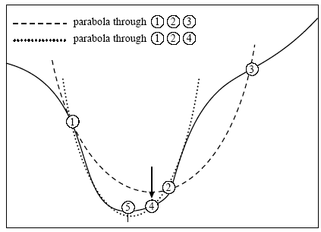
parabolic method for finding X
Now the rule of we can do better if F is nicely parabolic meadows the minimum.
If F is effectively parabolic on the interval [a, c], then we can analytically calculate the minimum
Note: only works if F is not linear
In practice, F is rarely exactly parabolic. However, one can use
It calculates X to find the new minimum supervision
For the next step
If F(x) < F(b)
Yes x <b then ABC = [a, x, b] (left)
If x> b then ABC = [x, b, c] (right)
If f(x) > f(b) then take the smallest segment bracketting b

Slide 21
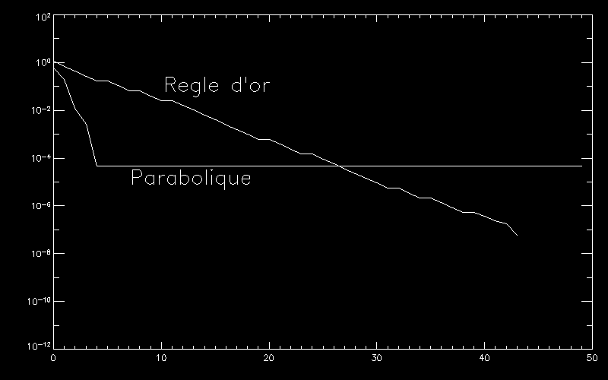
Comparison of two methods: minimization of Sin (x) ^ 2
Fault:
|| || AC / B
N iterations
We see that the parabolic method converges much faster that the method of the Golden Rule.
However its convergence is limited (> 10⁻⁵) .... Why ?

Slide 22
When the function is "flat" parabolic method becomes unstable
In practice what happens when the function is locally "flat"
An error digital precision can "go out" on the miminum interval

Slide 23
minimization Multi-Dimensional
Minimize F (X) wherein X = (x₁.... x_{not})
The problem is much more twisted ... and much longer to solve
The big problem is often the CHOICE of the descent direction
Once we know which direction we go down, the other problem is how the length the descent.
In N dimensions, these choices are crucial.

Slide 24
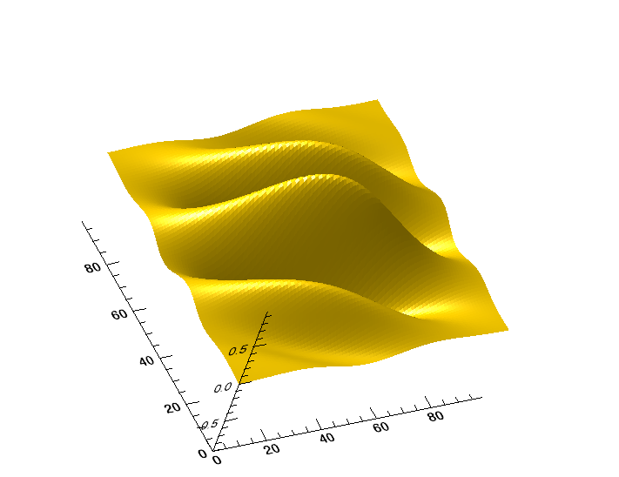
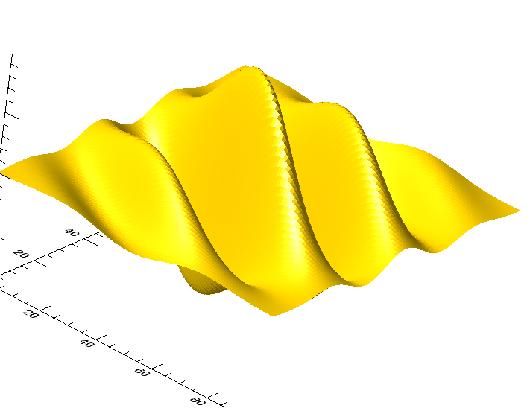
sample function to minimize, in 2D only F (x, y)

Slide 25
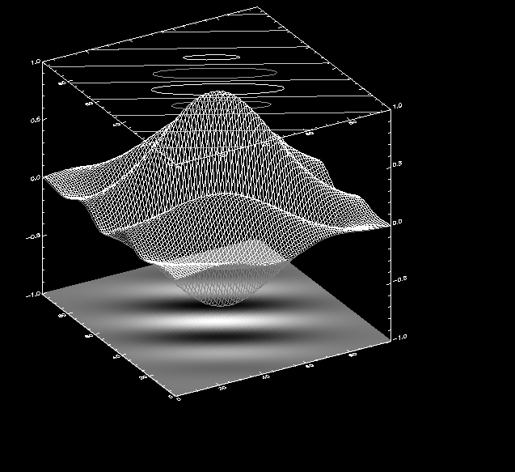
Here: several minimum,
Existence of "valleys" narrow,
Maximums and local minimums etc ...

Slide 26
Several techniques to tackle such a problem. Any is universally effective.
ALL require a starting point chosen by the user X₀
=> Need from a point X₀ not very far from the minimum
The greater part use the DL function of several variables (N variables)
X = P + [x₁, ..., x_{not}] where P is a vector
b is the gradient
A is called the "Hessian" f (x). It is simply the derivative matrix seconds at P.

Slide 27
Example Hessian: Here the function is f (x, y, z)
Hessian: A =
Calculated at the point P
While the term:
Is "Scalar Product X with AX "

Slide 28
Methods CLASSIC down the slopes. They fall into two main categories:
Methods that use several points: no gradient or Hessian
* Simplex Method (also called "Amoeba", "Amoeba" in English)
Mixed methods (multiple 1D minimizations):
* Relaxation
Methods using the gradient and the Hessian (if known)
fixed gradient descent (Gradient)
optimal gradient descent (Gradient Hessian +)
or conjugate gradient(Gradient Hessian +)
All the methods above converge to a local minimum

Slide 29
the highest and lowest point point were located.
Then you have to tighten the supervision step with some evolution rules
Reflection: one reflects the most points high in the opposite direction
Reflection + expansion
Contraction
multiple contraction

Slide 30
Mixed methods: Relaxation
The space in which we operate is orthonormal {e₁... e_{not}}
The idea is to break down a problem N-dimensional minimization in N problems 1D
The idea is to cycle through dimensions. On each dimension we perform 1D minimization.
1- Select an axis in {e₁... e_{not}} , beginning with e₁
2- Minimize function along this axis (any method) F (x_{i})
3- If the method has converged, redo same operation on the next axis.
4. If all the axes have been tested and that the method has not converged to the minimum, go back to e1

Slide 31
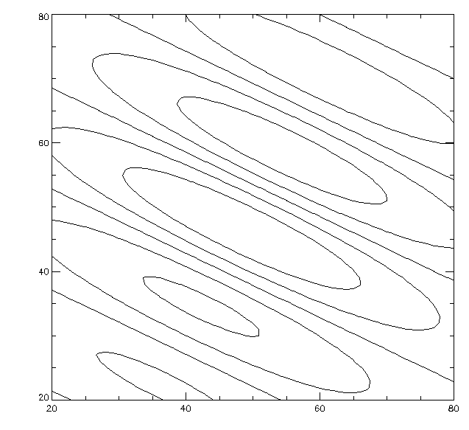
A 2D:
1- Get into the axis X
2- minimize along X
3. Stand on the axis Y
4 minimize along Y
5- Start in 1 if we have not reached the minimum

Slide 32
Note: "minimize along the axis e_{i} "means
When we develop P : P = (p₁..., p_{not})
minimizes the function G (x) = F [(p1, ..., p_{i}+ X, ip ..._{not} )]
Only i^{th} variable is evolving while p₁..., p_{not} are fixed.
So G (x) is a function of one single variable.
To conduct the minimization of G (x) one can use any method already seen in 1D.

Slide 33
GRADIENT DESCENT (also Steepest Descent)
the known gradient. Same method as 1D
We know F and F (X)
X is multidimensional X = (x₁ , ..., x_{not})
Starting from a starting point X₀
Is calculated following
where g_{k} is the direction of descent and_{k} is not downhill
g_{k} = (G_{k1} , ..., g_{kn}) gradient vector
d_{k} a real number
The choice of g_{k} is D_{k} will be such that F (X_{k + 1}) <F (X_{k})
In the simplest method of gradient descent , g is simply - the gradient of F

Slide 34
g₀
g₁
x₀
Example 1D
g_{i} is less gradient of point i
x₁
g₂
F (x)
x₂
x₄
g₃
g₄
x₃
g₅
x₅
X
Either one chooses_{k} as constant (d !!_{k} is a vector)

Slide 35
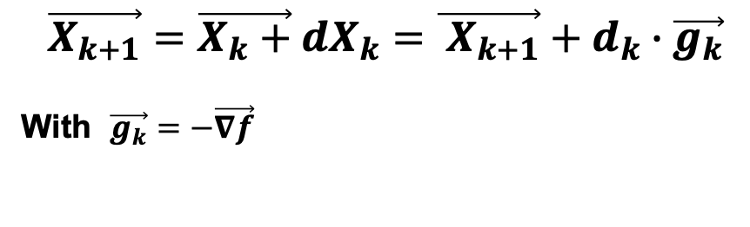
Steepest descent, either with fixed step, or with optimal step (using the HESSIAN)
$$\vec{X_{k+1}}=\vec{X_{k}+}dX_{k}=\vec{ X_{k+1}}+d_{k}∙\vec{g_{k}}$$
With $\vec{g_{k}}=−\vec{∇f}$
g_{k} is the direction : - gradient (vector)
d_{k} is the lentgh : scalar

Slide 36
The 1st and 2nd derivatives can be written as follows :.
$\vec{∇}f(X_{k}+dX_{k})≃$ $\vec{∇}f\left(X_{k}\right)+A\vec{dX_{k}}=\vec{g}+A\vec{dX_{k}}$
The idea is that we only go in the direction of the steepest descent (-gradient)
So $\vec{dX}$is always proportional to the gradient.

Slide 37
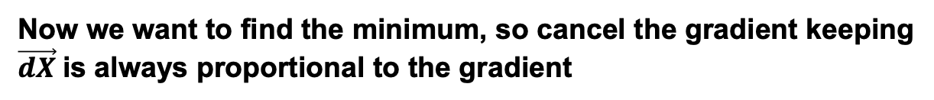
Now we want to find the minimum, so cancel the gradient keeping
$\vec{dX}$is always proportional to the gradient
d is the optimum distance

Slide 38
Summary:
At each step of calculation:
- Calculate the descent direction:
Calculate the length of descent:
Compute the new point X_{k}
REPEAT down to desired accuracy

Slide 39
But this method has its limitations:
Sometimes the steepest slope is not always optimal !!!
EXAMPLE:

Slide 40
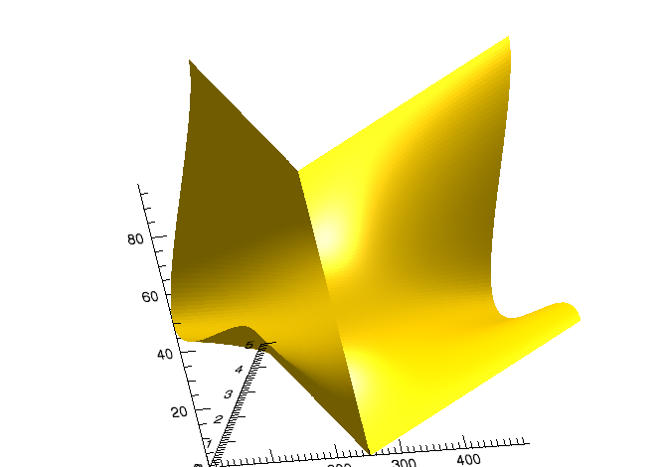
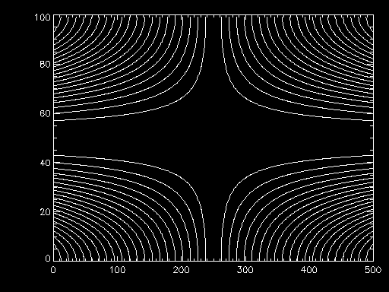
Either minimize F (x, y) (picture below)
Imagine that we are in a "valley" close.
The arrow is the direction of - gradient.
For yellow and orange dots gradient is not the best direction!
minimum
=> conjugate gradient

Slide 41
The algorithm will be like this:
where d_{k} is the distance of descent and u_{k} is the direction of descent.
BUT in the conjugate gradient method, u_{k} is not the gradient (a priori)
It will be something more complicated ..
In fact the descent direction u_{k} vary at each stage.
In particular, it must have
So 2 questions:
1) How to calculate the descent direction u_{k} ?
2) Knowing u_{k} what is the best value of the length of descent_{k} ?

Slide 42
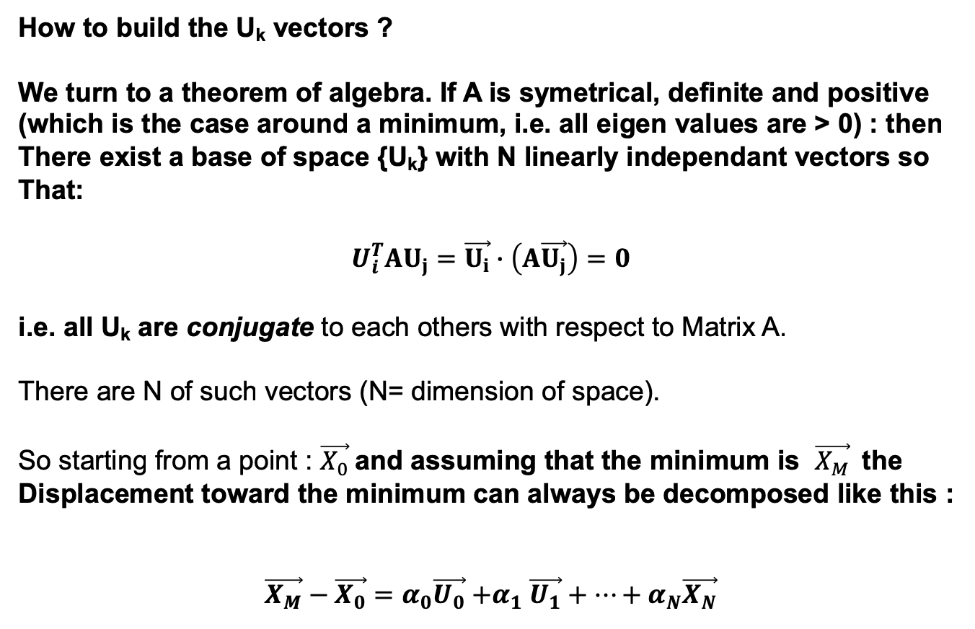
How to build the U_{k} vectors ?
We turn to a theorem of algebra. If A is symetrical, definite and positive
(which is the case around a minimum, i.e. all eigen values are > 0) : then
There exist a base of space {U_{k}} with N linearly independant vectors so
That:
$$U_{i}^{T}AU_{j}=\vec{U_{i}}∙\left(A\vec{U_{j}}\right)=0$$
i.e. all U_{k} are conjugate to each others with respect to Matrix A.
There are N of such vectors (N= dimension of space).
So starting from a point : $\vec{X_{0}}$and assuming that the minimum is $\vec{X_{M}}$the
Displacement toward the minimum can always be decomposed like this :
$$\vec{X_{M}}−\vec{X_{0}}=α_{0}\vec{U_{0}}{+α}_{1}\vec{U_{1}}+…+α_{N}\vec{X_{N}}$$
Iit simply states that any vector can be decomposed on the base of
Conjugate vectors with respect to A.

Slide 43
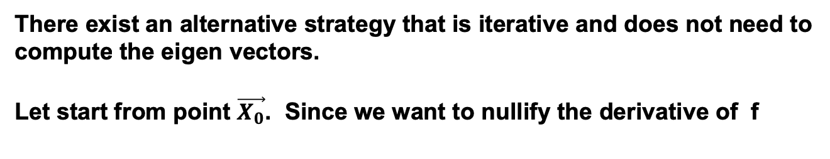
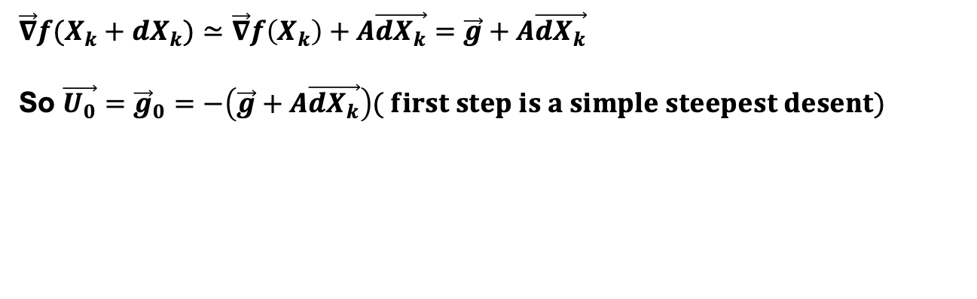
So far we have just assumed that the set of A-conjugate search directions exists. In practice we need a way to create it. There are several ways to choose such a set. The eigenvectors of A form a A-conjugate set, but finding the eigenvectors is a task requiring a lot of computations, so we better and another strategy.
There exist an alternative strategy that is iterative and does not need to compute the eigen vectors.
Let start from point $\vec{X_{0}}$. Since we want to nullify the derivative of f
$\vec{∇}f(X_{k}+dX_{k})≃$ $\vec{∇}f\left(X_{k}\right)+A\vec{dX_{k}}=\vec{g}+A\vec{dX_{k}}$
So $\vec{U_{0}}={\vec{g}}_{0}=−\left(\vec{g}+A\vec{dX_{k}}\right)( first step is a simple steepest desent)$

Slide 44
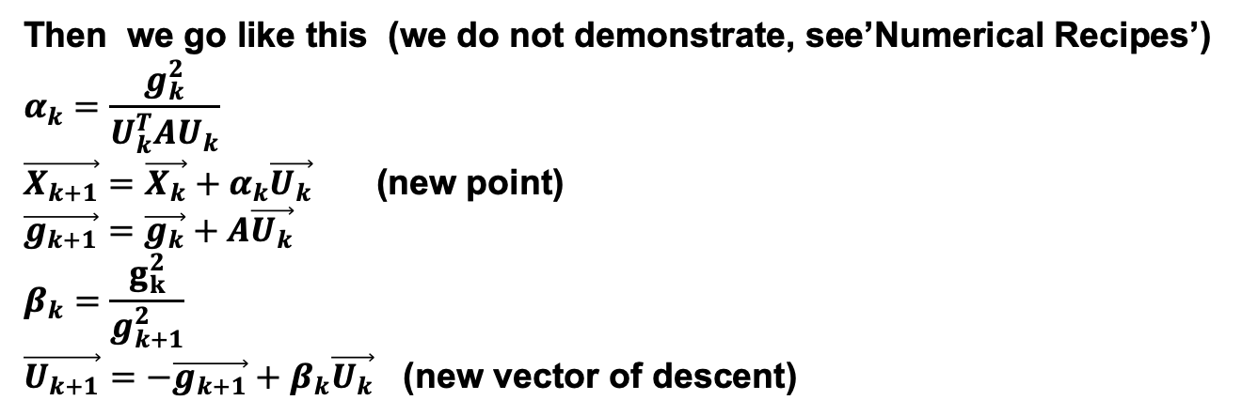
Then we go like this (we do not demonstrate, see’Numerical Recipes’)
$$α_{k}=\frac{g_{k}^{2}}{U_{k}^{T}AU_{k}}$$ $\vec{X_{k+1}}=\vec{X_{k}}+α_{k}\vec{U_{k}}$ (new point) $\vec{g_{k+1}}=$ $\vec{g_{k}}+A\vec{U_{k}}$ $$β_{k}=\frac{g_{k}^{2}}{g_{k+1}^{2}}$$ $\vec{U_{k+1}}=−\vec{g_{k+1}}+β_{k}\vec{U_{k}}$. (new vector of descent)

Slide 45
u_{k + 1}
It is seen that the U_{k} successive are perpendicular to each other.
A step started perpendicular to the lines levels
u_{k}

Slide 46
Convergence of conjugate gradient algorithm:
We can show that if f is EXACTLY quadratic
Then just N iterations N dimensions are necessary
In practice, one rarely investigates exactly quadratic functions
(If their minimum is analytically known).
So what if the algorithm does not converge after N iterations?
Simply restart from the last point obtained.

Slide 47
Interest of the conjugate gradient method:
VERY fast it converges to a minimum:
It can be shown that N-dimensional he simply steps N calculations
If the function is exactly square.
In practice :
Very often used in 'serious' calculations.
disadvantage:
Requires knowledge of the Hessian of the function F to determine the no descent.

Slide 48
The Fletcher-Reeves algorithm
This algorithm is based on the Conjugate Gradient
We have seen that the conjugate gradient algorithm chooses optimally descent directions through u_{k}.
The calculation of u_{k} does not explicitly call the Hessian
Then the function is minimized along the axis u_{k} => Minimizing 1D.
and the conjugate gradient, the length downhill d_{k}, Is calculated with the Hessian
Principle Fletcher Reeves
We use the same downward directions as the conjugate gradient
Is minimized along the axis u_{k} with classical minimization method to 1D
(Using 3 points for example).
advantage: no need to know the Hessian

Slide 49
In practice :
The Fletcher Reeves algorithm
0. Start a starting point X0
Calculate u_{k}
2. Minimize the function
d is a positive real. It is thus minimizing 1D. Use your method favorite (Trisection, quadrature etc ...). The minimum is to_{k}
3. X_{k + 1} is then
4. If you have not converged, again in 1

Slide 50
Fletcher-Reeves Convergence
It depends on your choice of minimization algorithm to 1D.
If you take the quadrature method, then, Fletcher-Reeves behavior will be very similar to the conjugate gradient.
Rule to always respect (for all algorithms):
When we get a minimum, we must restart algorithm for this (new starting point) to be * on * convergence.
Some authors advocate the algorithm periodically reset
(⬄ impose u_{k-1}= 0 )

Slide 51
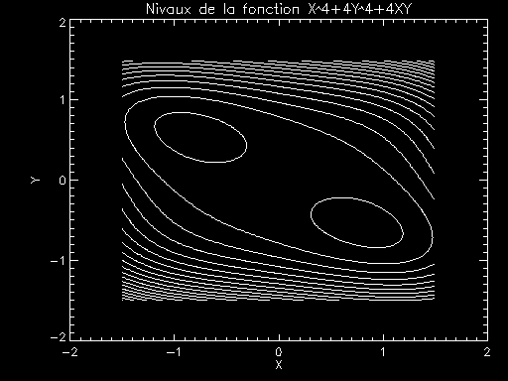
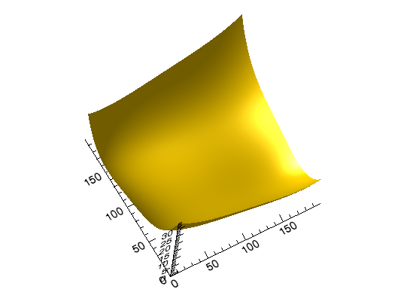
Fletcher Reeves Conjugate Gradient Vs.
It minimizes the function:
F (x, y) = x⁴four are⁴ 4x + y
Which has two real minimum
X * 1 = [- 8^{1/4} / 2, 2^{1/4}/ 2] X * 2 = [8^{1/4} / 2, -2^{1/4}/ 2]
X * 1 = [- 0.84, 0.59] X*2 = [0.84, -0.59]

Slide 52
Fletcher-Reeves, with 1D as minimization method the method of the "golden rule."
conjugate gradient
N iterations
Note 1:
The iteration nb does not depend much of the distance to the solution
Note 2:
The better Fletcher-Reeves with periodic stimulus
* No recovery
** revival every 2 iterations

Slide 53
Conclusion on deterministic methods:
They are very effective As the study is relatively simple function :
For example: quadratic function
They converge towards a LOCAL minimum :
It is never possible to say if you reach a local or a global minimum.
To find more minima must restart the algorithm with different starting points.
All methods presented here may not be effective if :
If the function has a complex shape with numerous dimensions. If there are many local minima "parasites"
Or if you need to know the minimum GLOBAL function:
We must then use other methods !!!

Slide 54
Method to find a global minimum:
"Simulated Annealing" in English
’Simulé recuit ’ in French ....
Also called "slow relaxation"
What to do to find a global minimum?
A possible method is "Simulated Annealing ». Another alternative is
« genetic algorithm »
Simulated anneaeling in recent years has solved very complex problems like "traveling salesman" where deterministic methods are quickly trapped in local minima.
We briefly describe here.
It is a type method "Monte Carlo" therefore requires random numbers .
It is inspired from thermodynamics ...

Slide 55
principle:
Natural systems spontaneously evolve towards a minimum energy or maximum total entropy:
Example: gas (maximum entropy)
spatial conformation of a molecule (minimum energy)
crystallization (maximum entropy)
etc ....
The system explores all possibilities during some time (slow relaxation) then stabilizes inside minimum. It is a cooling process.
Over this cooling is slower, the system will be close to the absolute minimum.
The function F (X) will be called to minimize the according to "cost."
We must therefore minimize the "cost"

Slide 56
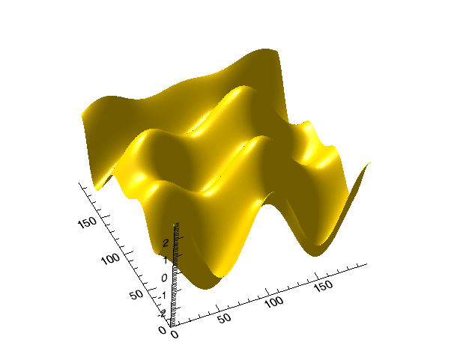
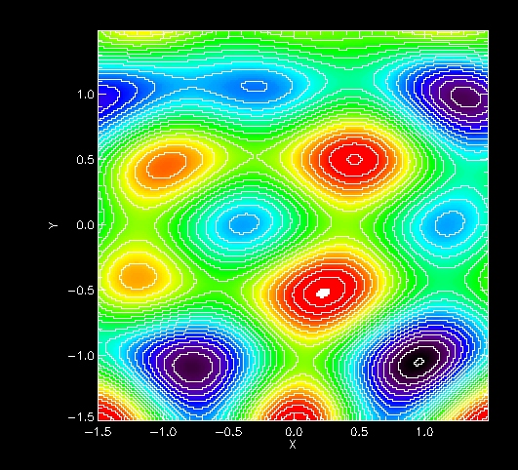
Example: Here is a function F (X, Y) which it is very difficult to determine the minimum absolute. A deterministic method will give you just the nearest local minimum.

Slide 57
Now let’s get inspired from thermodynamics:
In thermodynamics the probability of an energy state E is
Expressing the idea that if a system is in thermal equilibrium at temperature T, then its possible energy states are distributed probabilistically with a probability distribution that decreases exponentially with energy.
So even if the lower energy state is most likely, it is still possible to "jumps" (with low probability) through a local minima of energy, but then eventually converge to the global energy minimum.
So sometimes the system goes back to larger energies , but in average it gets down towards lower energies.
This is the FORCE of this approach. A deterministic method cannot do that

Slide 58
The simulated-annealing method uses that probability.
E is the cost function F: F is the function fo be minimized. It is treated as an energy
T is a dummy control parameter is slowly decrease the temperature T of the system.
The Boltzmann constant K will be replaced by an arbitrary constant
so that P (E) is a number accessible by the machine.
The probability of passing from one state E_{k} to state E_{k + 1} will be :
If E_{k + 1} <E_{k} then P> = 1 => The transition is always accepted. (it minimizes !!!)
If E_{k + 1} > E_{k} so 0 <P <1 => pulling a figure X between 0 and 1. If X <P then the transition is accepted

Slide 59
In practice, the method will be:
1- Starting from Ek energy, and a temperature T
2 randomly generate a new state, K + 1, close to the K state, energy Ek + 1 (ΔE ~ KT)
3- Let’d chek if we accept the state K + 1
For this we calculate the transition from K to to K + 1:
Draw a random number between 0 and 1 X (distrib. Uniform)
If X> P then accept it, otherwise it reject it
4- When I no longer decreases, it decreases T and start again in 1
Surgery repeated N times constant T
In step 2, the random generator should be able to generate new whose configurations ΔE Typical is about KT ...
It is in step 2 that hides the effectiveness of the method.

Slide 60
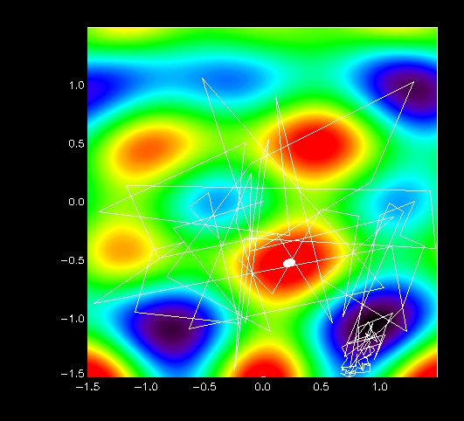
example:
Starting point:
[0,0]
Arrival point :
[0.68, -1.42]
10⁵ iterations
310 changes accepted

Slide 61
Conclusion on simulated annealing:
Method that can be effective when seeking an absolute minimum.
The result depends STRONGLY on method used to generate a new random state.
Very time consuming calculation => Use only if other methods are ineffective.
The method of "simulated annealing" is the basis of other methods of simulations type of physical "Monte Carlo" called "Metropolis" methods for simulate a gas or a crystal.
Alternative to simulated annealing: Genetic Algorithms.

Slide 62
Conclusion on minimizing without restraint
The problem is to minimize a function F (X) N unconstrained dimensions on X.
All methods require X0 start.
Deterministic methods converge to the local minimum the closest.
The more you know about the function (Gradient, Hessian) plus minimization will be effective. (Conjugate gradient, Fletcher-Reeves)
. Methods to Sun N ALL trying to reduce the problem to one dimension: it minimizes successively given directions
If the function is "noisy" of many local minima ... then we must used a method of the type "slow relaxation" as the "Simulated Anealing".
This is a Monte Carlo method.
But the price is ... (1) a time of great computing
(2) There must be a generator of new states effective and there is no "practical recipe"

Slide 63
Minimization Constraint
Many problems in physics, engineering and economics require minimize function but soums to several constraints.
Examples:
aeronautics:
The optimal design of a wing that minimizes friction but ensure that
Constraints on the wing are not too strong.
Chemistry:
Chemical composition in equilibrium, which minimizes the Gibbs energy but which retains the total mass
Etc ...

Slide 64
Several techniques exist.
We shall see one here, which is often found in thermodynamics:
The method of Lagrange multipliers.
Method can also be used analytically.

Slide 65
The Lagrange multipliers method can solve the following problem:
Let X= [X1, x2, ..., xn] a set of N variables
We want to minimise f (X) knowing that X is constrained so that we want g (X) = 0
Example (from economy):
We want to maximize the function:
X and Y represent them working investment (x) and capital (y)
Knowing that the total cost is

Slide 66
If there was no constrain, it would suffice to increase x and y indefinitely.
But the constraint g (x, y) = c makes this impossible.
So we need to maximize f (x, y) with constrain g(x, y) = c
It is a typical a « constrained optimization problem ».
How to solve this problem ?
Let's F study the level lines of F, for constant values of G
We will take for g (x, y) = c ⬄ x + y = 3.78 ...

Slide 67
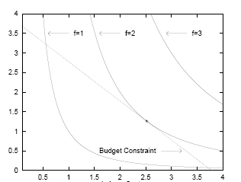
level lines f
there
G (x, y)
X
Note that at the level of the possible solution (red) of the f level line
Is parallel to the line level g.
So:

Slide 68
graphic demonstration
G(x,y)= x + y -c
Gradient f
F line level
Gradient G
Constraint G (x, y)=0
: F can be increased again, moving to the right or left
: One cannot increase f: the left and right directions always minish f

Slide 69
Both conditions are met : maximum of F + satisfying constraint G
"gradient of F and of G are parallel "
is called "Lagrange Multiplier"
N equations (All gradients)
with N unknowns (x, y, z, etc ...)
+ 1 equation: G (x, y) = 0 One unknown:λ
So N + 1 equations a N + 1 unknowns

Slide 70
This system is then solved numerically
Summary : It maximizes F (X) with the constraint G (X) = 0. X a vector with N components
1- Define H (X,λ) = F (x) -λG (X)
2- Write
3. Find the x_{i} and λ of N equations

Slide 71
example:
We want to produce cylindrical cans of volume V0 set but
Minimum area of ​​S. Both parameters are r and h
Function to be minimized
constraints
3 equations
3 unknowns: r, h,λ

Slide 72
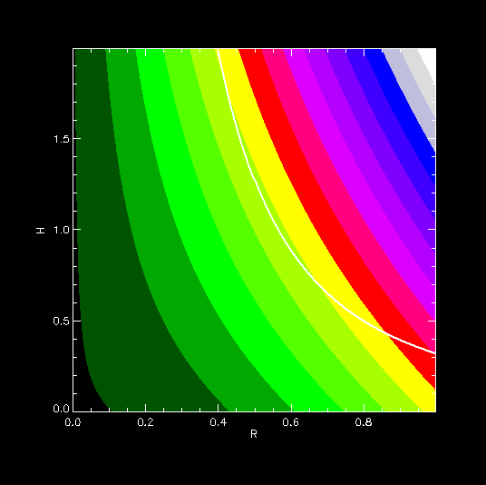
System of nonlinear equations solved by substitution
Colors: levels Lines S maximize
Online: Constraint Pi r² h = V₀= 1

Slide 74
V = 1

Slide 75
What to do when we have more than ONE constraint?
We introduce as many as Lagrange multipliers as constraints:
Example : N variables and M constraints
Let x1, ..., Xn N variables.
We want to maximize F (x1, ..., x N)
With M constraints G_{i}(X1, ..., Xn) = 0, for i = 1 ... M
Method
Lagrange multipliers are introduced M: λ₁..., λ_{M}
N equations :
The M + constraints. This allows to findλ_{i} and all x_{i}

Slide 76
The Lagrange multipliers method is the simplest method to optimize a problem with constraints.
the parameter λ has no real meaning here.
Other methods exist that we will not be detailed here.
It is widely used in thermodynamics where, for example, it allows to calculate the chemical equilibrium composition of a chemical reaction

Slide 77
Summary: How to tackle a minimization problem
Either minimize the function F (x1, ..., Xn) N variables.
Is the problem constrained ?
If yes: Lagrange multipliers or other
2. Is the a simple problem? (Idea of ​​the minimum, absence of many parasite minima)
If yes then we can use all the deterministic methods
3. Simple Problem: Do you know the gradient of F?
If yes , you are in the best case: use eg conjugate gradient (Hessian) or Fletcher Reeves
If not, and N = 1: Use a method of trisection and quadrature
If not, and N> 1: Only the "Amoeba" method ( "Amoeba") or mixed method
not studied here
4. If the problem is complex (No idea of ​​the minimum several parasites minima etc ...)
You are in the most difficult cases. Try a Monte Carlo method such as simulated annealing ( "Simulated Annealing"). Or check genetic algorithm.

